Slide 1
Fault Tolerance

Slide 2
Learning Objectives
Define fault tolerance in relation to distributed systems.
Describe process resilience and its contribution towards the design and implementation of fault tolerant distributed systems.
Define the distributed commit and the recovery process in as far as implementation of fault tolerant distributed systems.
Notes:
Students may not know exactly what is meant by globalization or may have an incomplete understanding of the term. You might ask students what they think it means. Potential answers could include: reduction of economic and cultural advantages of developed countries, increased number of companies with operations in multiple countries worldwide, and increased reliance on imports and exports of goods (and jobs). Globalization will be discussed in later slides as well.

Slide 3
Fault Tolerance
“A distributed system is one in which the failure of a computer you didn’t even
know existed can render your own computer unusable” Leslie Lamport, May 1987.
Part I Introduction
Part II Process Resilience
Part III Reliable Communication
Part IV Distributed Commit
Part V Recovery

Slide 4
Fault Tolerance
A DS should be fault-tolerant;
  Should be able to continue functioning in the presence of faults.
Fault tolerance is related to dependability.

Slide 5
Dependability
Dependability Includes;
Availability
Reliability
Safety
Maintainability

Slide 6
Availability & Reliability
Availability: a measurement of whether a system is ready to be used immediately.
  System can be up and running at any given moment.
Reliability: a measurement of whether a system can run continuously without failure.
  System continues to function for a long (extended) period of time.

Slide 7
Availability & Reliability…
A system goes down 1ms/hr has an availability of more than 99.99%, but is unreliable.
A system that never crashes but is shut down for a week once every year is 100% reliable but only 98% available.

Slide 8
Safety & Maintainability
Safety: A measurement of how safe failures are
  System fails, nothing serious happens
  For instance, high degree of safety is required for systems controlling nuclear power plants.
Maintainability: A measurement of how easy it is to repair a system.
  A highly maintainable system may also show a high degree of availability.
  Failures can be detected and repaired automatically. Self-healing systems?

Slide 9
Faults
A system fails when it cannot meet its promises (specifications).
An error is part of a system state that may lead to a failure
A fault is the cause of the error.
Fault-Tolerance: the system can provide services even in the presence of faults.
Faults can be:
  Transient (appear once and disappear).
  Intermittent (appear-disappear-reappear behavior)
    A loose contact on a connector ➔intermittent fault
  Permanent (appear and persist until repaired).

Slide 10
Failure Models
Type of Failure | Description
Crash failure | A server halts, but is working correctly until it halts
Omission failure Receive omission Send omission | A server fails to respond to incoming requests A server fails to receive incoming messages A server fails to send messages
Timing failure | A server's response lies outside the specified time interval
Response failure Value failure State transition failure | The server's response is incorrect The value of the response is wrong The server deviates from the correct flow of control
Arbitrary failure (Byzantine failure) | A server may produce arbitrary responses at arbitrary times
Table 1-1: Failure Models

Slide 11
Failure Masking
Redundancy is key technique for hiding failures.
Redundancy types:
Information: add extra (control) information
  Error-correction codes in messages
Time: perform an action persistently until it succeeds:
  Transactions
Physical: add extra components (S/W & H/W)
  Process replication, electronic circuits.

Slide 12
Fault Tolerance
Part I Introduction
Part II Process Resilience
Part III Reliable Communication
Part IV Distributed Commit
Part V Recovery

Slide 13
Process Resilience
Principles:
  Mask process failures by replication.
  Organize processes into groups, a message sent to a group is delivered to all members.
  If a member fails, another should fill in.

Slide 14
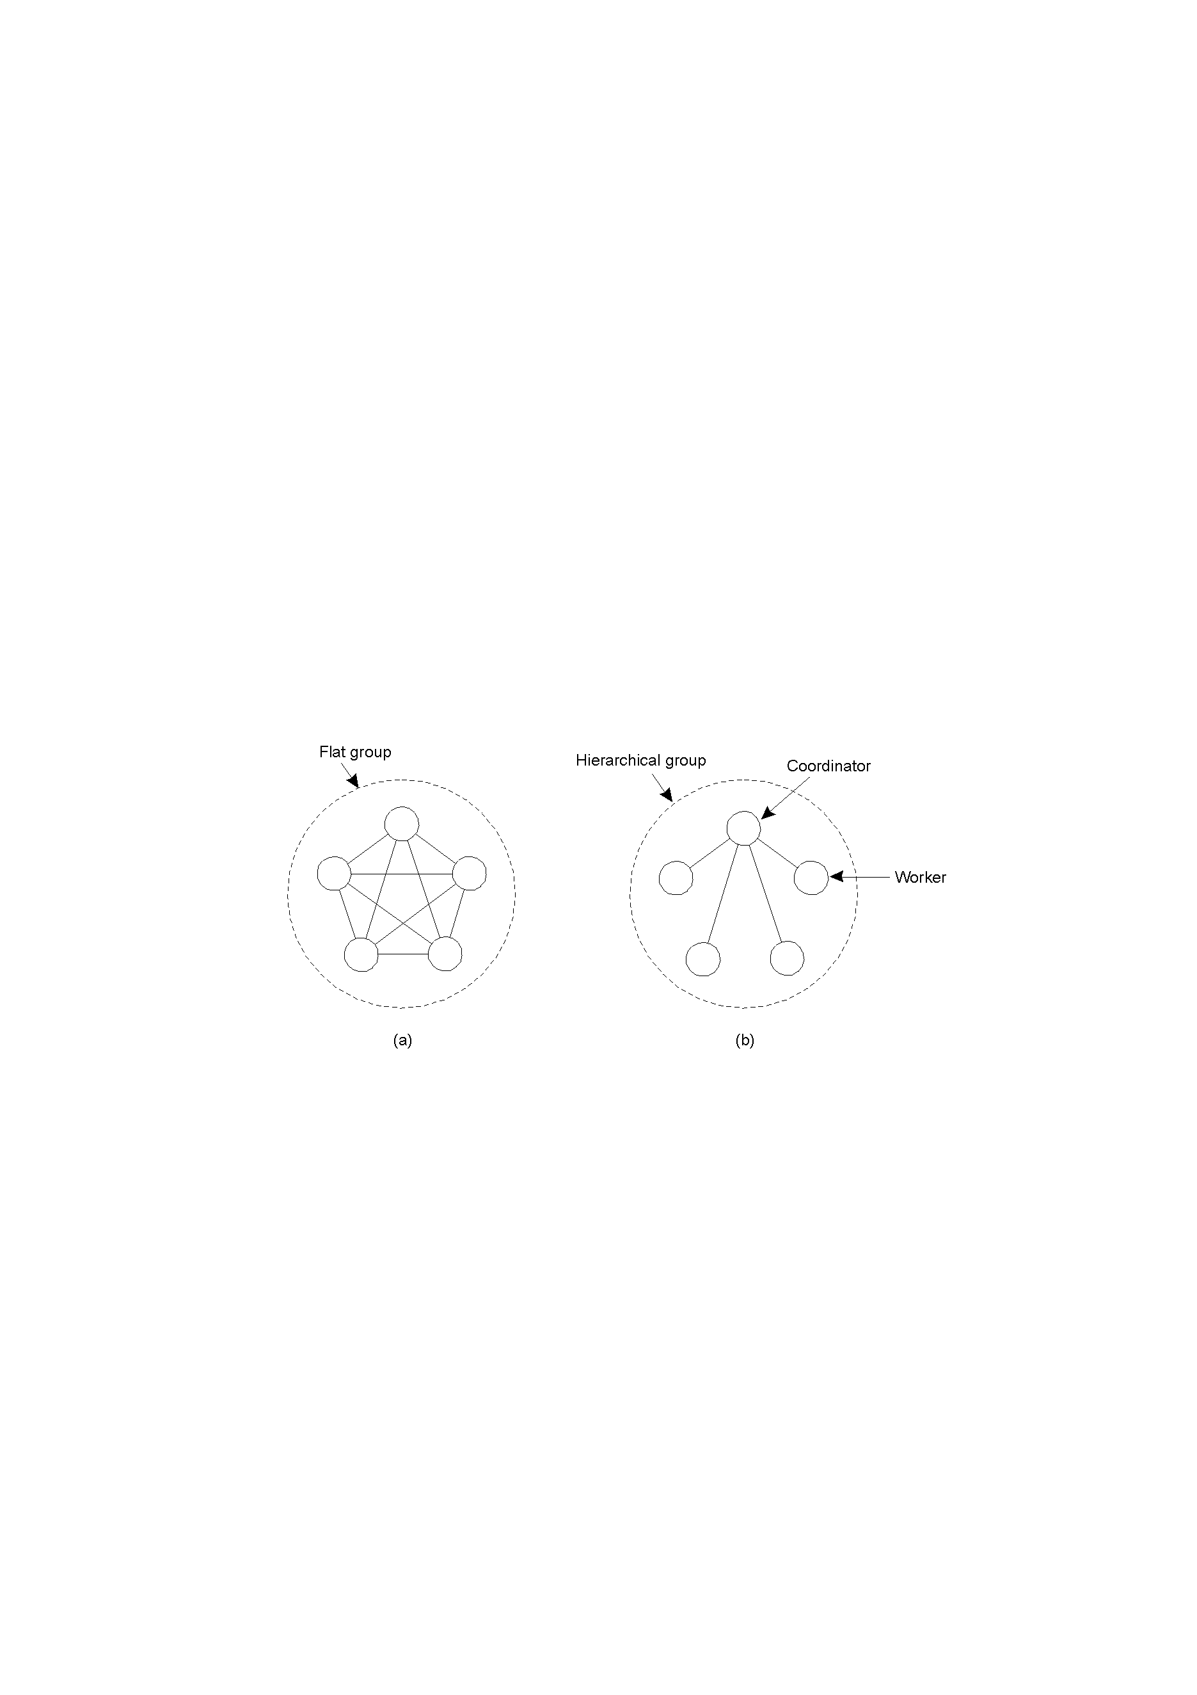
Flat Groups vs Hierarchical Groups
Communication in a flat group.
Communication in a simple hierarchical group
Figure 1-1: Groups

Slide 15
Process Replication
Replicate a process and group replicas in one group.
How many replicas do we create?
A system is k fault-tolerant if it can survive and function even if it has k faulty processes;
  For crash failures (a faulty process halts, but is working correctly until it halts)
    k+1 replicas
  For Byzantine failures (a faulty process may produce arbitrary responses at arbitrary times).
    2k+1 replicas

Slide 16
Agreement
Need agreement in DS:
  Leader, commit, synchronize.
Distributed Agreement algorithm: all non-faulty processes achieve consensus in a finite number of steps.
Perfect processes, faulty channels: Two-Army problem
Faulty processes, perfect channels: Byzantine generals problem.

Slide 17
Two-Army Problem
Figure 1-2: Two-Army Problem
Notes:
In this example, Enemy Red Army has 5000 troops. Blue Army has two separate gatherings, Blue (1) and Blue (2), each of 3000 troops. Alone Blue will loose, together as a coordinated attack Blue can win. Communications is by unreliable channel (send a messenger who may be captured by red army so may not arrive.

Slide 18
Byzantine Generals Problem
Origin of Byzantine Agreement:
  Byzantium, 1453 AD - The city of Constantinople, the last remnants of the ancient Roman Empire under siege.
  Ottoman battalions camped around the city, poised to launch the next, perhaps final, attack.
  Sitting in their respective camps, generals meditate. Because of fortifications, no battalion by itself can succeed; attack must be by several of them together.

Slide 19
Byzantine Generals Problem…
Origin of Byzantine Agreement:
  Generals can agree on a common plan of action by communicating thanks to the messenger service of the Ottoman Army which can deliver messages within an hour, certifying the identity of the sender and preserving the content of the message.
  Some generals however, are secretly conspiring against the others. Their aim is to confuse their peers so that an insufficient number of generals is deceived into attacking.

Slide 20
Byzantine Generals Problem…
Origin of Byzantine Agreement:
  The resulting defeat will enhance their own status in the eyes of the Grand Sultan.
  The generals start shuffling messages around, the ones trying to agree on a time to launch the offensive, the others trying to split their ranks...
  classical coordination problem in distributed computing known as byzantine agreement.
  basic problem in distributed computing: Can a set of concurrent processes achieve coordination in spite of the faulty behaviour of some of them?

Slide 21
Byzantine Generals Problem…




Figure 1-3: Byzantine Generals Problem

Slide 22
Fault Tolerance
Part I Introduction
Part II Process Resilience
Part III Reliable Communication
Part IV Distributed Commit
Part V Recovery

Slide 23
Reliable Group Communication
When a group is static and processes do not fail;
Reliable communication = deliver the message to all group members:
  Any order delivery
  Ordered delivery

Slide 24
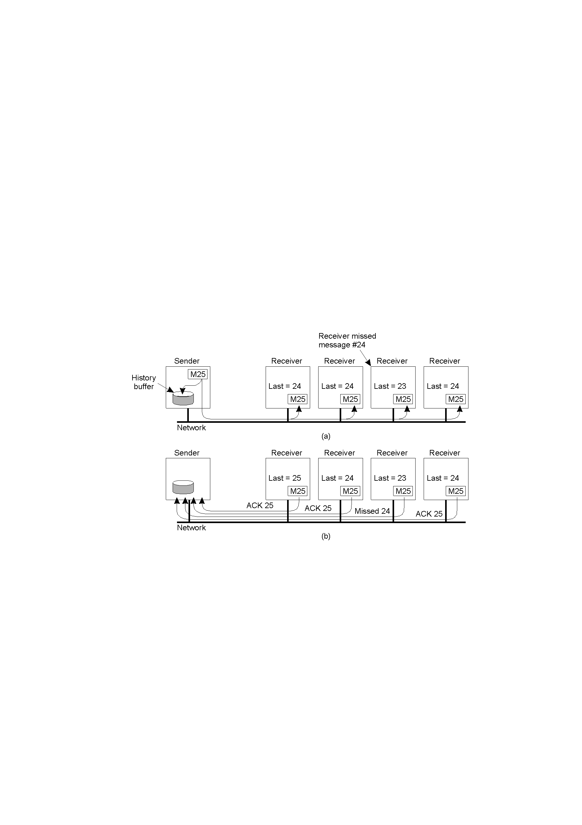
Basic Reliable-Multicasting Schemes
Figure 1-4: Basic Reliable-Multicasting
A simple solution to reliable multicasting when all receivers are known and assumed not to fail;
Message transmission
Reporting feedback

Slide 25
Atomic Multicast
ALL messages are delivered in the same order to “all” processes;
Group view: the view on the set of processes contained in the group.
Virtual synchronous multicast: a message m multicast to a group view G is delivered to all non-faulty processes in G.

Slide 26
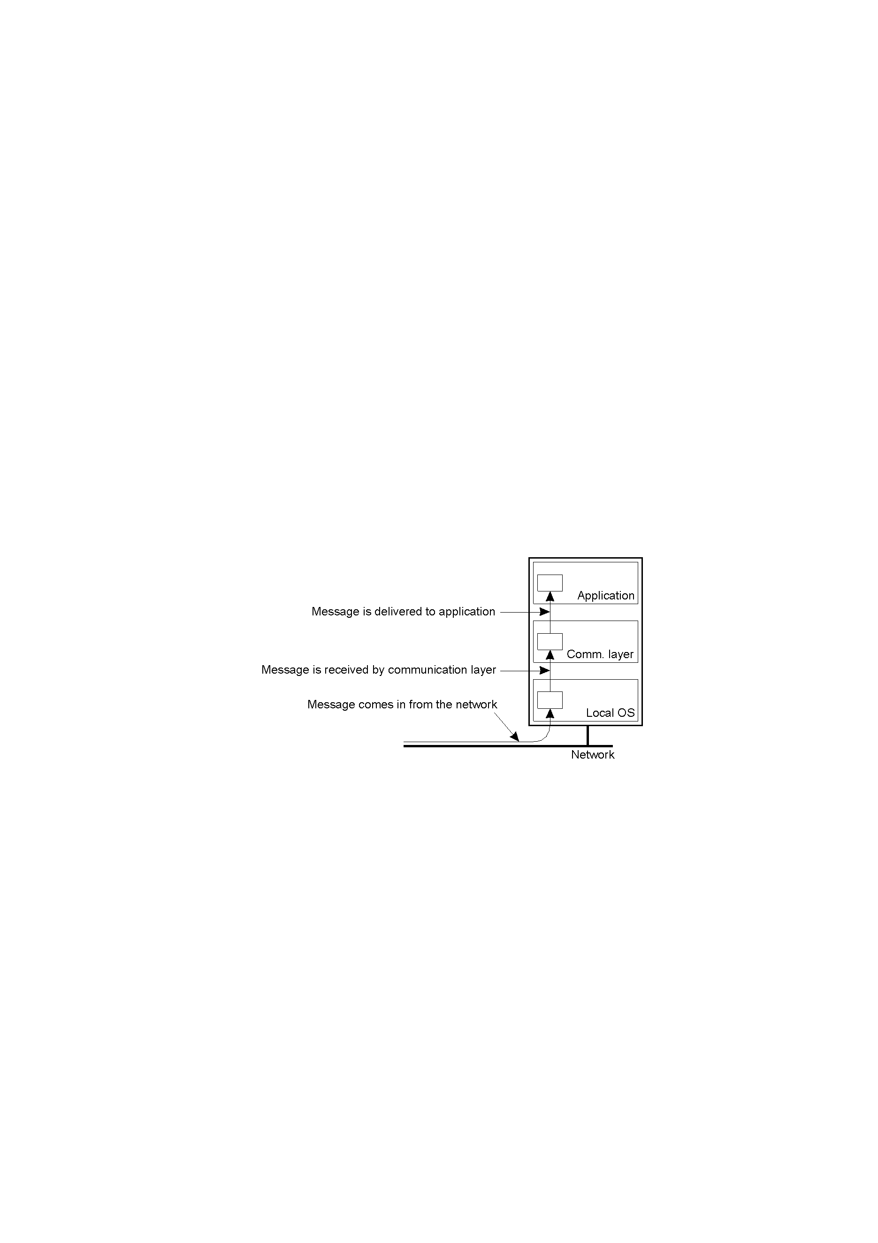
Virtual Synchrony System Model
Figure 1-5: Virtual Synchrony System Model
The logical organization of a distributed system to distinguish between message receipt and message delivery.

Slide 27
Message Delivery
Application
Delivery of messages
new message => HBQ
decision making
  delivery order
  deliver or not to deliver?
the message is allowed to be
delivered: HBQ => DQ
when at the head of DQ:
message => application
(application: receive …)
delivery
hold-back queue
delivery queue
Message passing system
Figure 1-6: Message Delivery
HBQ: Hold Back Queue
DQ: Delivery Queue

Slide 28
Virtual Synchronous Multicast
a) Message is not delivered
b) Message is delivered
A
A
B
B
C
C
G_{i} = (A, B, C)
G_{i+1} = (B, C)
G_{i} = (A, B, C)
G_{i+1} = (B, C)
Figure 1-7: Multicast Group Message Delivery

Slide 29
Virtual Synchronous Multicast
a) Message is not delivered
b) ???
A
A
B
B
C
C
G_{i} = (A, B, C)
G_{i+1} = (B, C)
G_{i} = (A, B, C)
G_{i+1} = (B, C)
Figure 1-8: Multicast Group Message Delivery

Slide 30
Virtual Synchronous Multicast
a) ???
A
B
C
G_{i} = (A, B, C)
G_{i+1} = (B, C)
Figure 1-9: Multicast Group Message Delivery

Slide 31
Reliability of Group Communication?
A sent message is received by all members
(acks from all => ok).
Problem: during a multicast operation
  an old member disappears from the group
  a new member joins the group.
Solution
  membership changes synchronize multicasting
    during a MC operation, no membership changes
  Virtual synchrony: “all” processes see message and membership change in the same order.

Slide 32
Virtual Synchrony
Implementation done by Birman et al, 1991;
  Only stable messages are delivered.
  Stable message: a message received by all processes in the message’s group view.
  Assumptions (can be ensured by using TCP):
  i) Point-to-point communication is reliable
  ii) Point-to-point communication ensures FIFO-ordering
How to determine if a message is stable?

Slide 33
Virtual Synchrony Implementation
Example:
G_{i} = {P1, P2, P3, P4, P5}
P5 fails
P1 detects that P5 has failed
P1 sends a “view change” message to every process in G_{i+1} = {P1, P2, P3, P4}
P2
P3
P1
change view
P4
P5
Figure 1-10: Virtual Synchrony

Slide 34
Virtual Synchrony Implementation…
Example:
unstable message
Every process
  Sends each unstable message m from G_{i} to members in G_{i+1}
  Marks m as being stable
  Sends a flush message to mark that all unstable messages have been sent.
P2
P3
P1
flush
message
P4
P5
Figure 1-11: Virtual Synchrony

Slide 35
Virtual Synchrony Implementation…
Example:
Every process
  After receiving a flush message from all processes in G_{i+1} installs G_{i+1}
P2
P3
P1
P4
P5
Figure 1-12: Virtual Synchrony

Slide 36
Fault Tolerance
Part I Introduction
Part II Process Resilience
Part III Reliable Communication
Part IV Distributed Commit
Part V Recovery

Slide 37
Distributed Commit
Goal: Either ALL members of a group decide to perform an operation, or NONE of them perform the operation.
Atomic Transaction: a transaction that happens completely or not at all.

Slide 38
Assumptions
Failures:
  Crash failures that can be recovered
  Communication failures detectable by timeouts
Notes:
  Commit requires a set of processes to agree…
  …similar to the Byzantine generals problem…
  … but the solution much simpler because stronger assumptions.

Slide 39
Distributed Transactions
client
ser-ver
Database
atomic
ser-ver
Atomic
Consistent
Isolated
Durable
isolated
serializable
ser-ver
Database
client
Figure 1-13: Virtual Synchrony

Slide 40
ACID Properties
ACID (Atomicity, Consistency, Isolation, Durability): a set of properties that guarantee that distributed systems transactions are processed reliably.
  In the context of databases, a single logical operation on the data is called a transaction. E.g. a transfer of funds from one bank account to another, even involving multiple changes such as debiting one account and crediting another, is a single transaction.
  In 1983, Andreas Reuter and Theo Härder coined the acronym ACID to describe them.

Slide 41
ACID Properties
Atomicity: each transaction is "all or nothing": if one part of the transaction fails, the entire transaction fails, and the database state is left unchanged e.g. subtract 10 from A and add 10 to B.
Consistency: the data must meet all validation rules e.g. the validation may be a requirement that A + B = 100. Also, it may be inferred that both A and B must be integers. A valid range for A and B may also be inferred. All validation rules must be checked to ensure consistency.

Slide 42
ACID Properties
Isolation: ensures that the concurrent execution of transactions results in a system state that would be obtained if transactions were executed serially i.e. one after the other. Providing isolation is the main goal of concurrency control.
Durability: once a transaction has been committed, it will remain so, even in the event of power loss, crashes or errors.

Slide 43
A Distributed Banking Transaction
openTransaction
join
participant
closeTransaction
A
a.withdraw(4);
join
BranchX
T
participant
Client
B
b.withdraw(3);
T =
openTransaction
BranchY
a.withdraw(4);
join
c.deposit(4);
participant
b.withdraw(3);
d.deposit(3);
C
c.deposit(4);
closeTransaction
D
d.deposit(3);
BranchZ
Figure 1-14: Virtual Synchrony

Slide 44
One-phase Commit
One-phase commit protocol;
  One site is designated as a coordinator
  The coordinator ‘tells’ all the other processes whether or not to locally perform the operation in question.
  This scheme however is not fault tolerant.

Slide 45
Transaction Processing
S1
F1
coordinator
T_Id
client
….
Open transaction
T_write F1,P1
T_write F2,P2
T_write F3,P3
Close transaction
….
flag: init
P1
27
join
S2
F2
T_Id
flag: init
participant
P2
27
S3
F3
T_Id
participant
flag: init
P3
2745
Figure 1-15: One-phase Commit

Slide 46
Transaction Processing…
F1
Close
coordinator
T_Id
client
….
Open transaction
T_read F1,P1
T_write F2,P2
T_write F3,P3
Close transaction
….
committed
wait
canCommit?
init
done
doCommit !
P1 | 27
HaveCommitted
Yes
T_Id
committed
ready
init
P2 | 27
Yes
HaveCommitted
T_Id
committed
ready
init
P3 | 2745
Figure 1-16: One-phase Commit

Slide 47
Two Phase Commit (2PC)
Coordinator
Participants
send VOTE_REQ to all
send vote to coordinator
if (vote == no)
decide abort
halt
if (all votes yes)
decide commit
send COMMIT to all
else
decide abort
send ABORT to all who voted yes
halt
if receive ABORT, decide abort
else decide commit
halt
Figure 1-17: Two-phase Commit

Slide 48
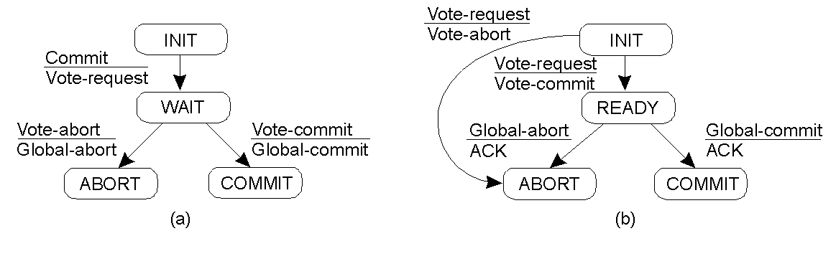
Two-Phase Commit…
The finite state machine for the coordinator in 2PC.
The finite state machine for a participant.
Figure 1-18: Two-phase Commit FSMs

Slide 49
Two-Phase Commit…
State of Q | Action by P
COMMIT | Make transition to COMMIT
ABORT | Make transition to ABORT
INIT | Make transition to ABORT
READY | Contact another participant
Actions taken by a participant P when residing in state READY and having contacted another participant Q.
Table 1-2: Two-phase Commit

Slide 50
Two-Phase Commit…
actions by coordinator:
write START _2PC to local log;
multicast VOTE_REQUEST to all participants;
while not all votes have been collected {
wait for any incoming vote;
if timeout {
write GLOBAL_ABORT to local log;
multicast GLOBAL_ABORT to all participants;
exit;
}
record vote;
}
if all participants sent VOTE_COMMIT and coordinator votes COMMIT{
write GLOBAL_COMMIT to local log;
multicast GLOBAL_COMMIT to all participants;
} else {
write GLOBAL_ABORT to local log;
multicast GLOBAL_ABORT to all participants;
}
Outline of the steps taken by the coordinator in 2PC.

Slide 51
Two-Phase Commit…
actions by participant:
write INIT to local log;
wait for VOTE_REQUEST from coordinator;
if timeout {
write VOTE_ABORT to local log;
exit;
}
if participant votes COMMIT {
write VOTE_COMMIT to local log;
send VOTE_COMMIT to coordinator;
wait for DECISION from coordinator;
if timeout {
multicast DECISION_REQUEST to other participants;
wait until DECISION is received; /* remain blocked */
write DECISION to local log;
}
if DECISION == GLOBAL_COMMIT
write GLOBAL_COMMIT to local log;
else if DECISION == GLOBAL_ABORT
write GLOBAL_ABORT to local log;
} else {
write VOTE_ABORT to local log;
send VOTE ABORT to coordinator;
}
Steps taken by participant process in 2PC.

Slide 52
Two-Phase Commit…
actions for handling decision requests: /* executed by separate thread */
while true {
wait until any incoming DECISION_REQUEST is received; /* remain blocked */
read most recently recorded STATE from the local log;
if STATE == GLOBAL_COMMIT
send GLOBAL_COMMIT to requesting participant;
else if STATE == INIT or STATE == GLOBAL_ABORT
send GLOBAL_ABORT to requesting participant;
else
skip; /* participant remains blocked */
Steps taken by participant process for handling incoming decision requests.

Slide 53
Two-Phase Commit…
Summary:
  standard protocol in distributed transactions for achieving ACID properties. Each transaction has a coordinator who initiates and coordinates the transaction.
  coordinator sends a prepare message to all participants (nodes) and waits for their answers.
  coordinator then sends nodes’ answers to all other sites.
  each participant waits for these answers from the coordinator before committing to or aborting the transaction.
  if committing, coordinator records this into a log and sends a commit message to all participants.

Slide 54
Two-Phase Commit…
Summary…:
  if for any reason a participant aborts the process, the coordinator sends a rollback message and the transaction is undone using the log file created earlier.
  Advantage is all participants reach a decision consistently, yet independently.
Two-phase commit is a blocking commit protocol;
  participants will block resource processes while waiting for a message from the coordinator.
  coordinator also blocks resources while waiting for replies from participants hence coordinator can also block indefinitely if no acknowledgement is received from the participant.

Slide 55
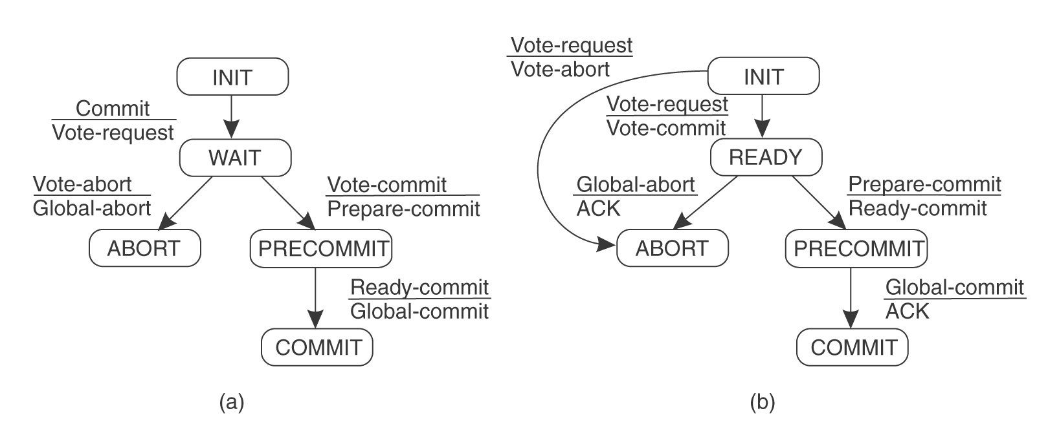
Three-Phase Commit
Figure 1-19: Three-phase Commit FSMs
⇒ A non-blocking commit protocol.

Slide 56
Three-Phase Commit…
Coordinator sends Vote_Request (as before).
If ALL participants respond affirmatively;
    Put Precommit state into log on stable storage
    Send out Prepare_to_Commit message to ALL.
After ALL participants acknowledge;
    Put Commit state in log.
    Send out Global_Commit.

Slide 57
Three-Phase Commit…
Coordinator Blocked:
If coordinator blocked in Wait state;
    Safe to abort transaction
If coordinator blocked in Precommit state;
    Safe to issue Global_Commit
    ANY crashed or partitioned participants will commit when recovered.

Slide 58
Three-Phase Commit…
Participant Blocked:
If participant blocked in Precommit state;
    Contact others
    Collectively decide to commit.
If participant blocked in Ready state;
    Contact others
    If ANY in Abort, then abort transaction
    If ANY in Precommit, then move to Precommit state
    If ALL in Ready state, then abort transaction.

Slide 59
Three-Phase Commit…
Summary:
  a non-blocking protocol developed to avoid the failures that occur in two-phase commit transactions.
  also has a coordinator who initiates and coordinates the transaction.
  however, it introduces a third phase called the pre-commit.
  aim: to 'remove the uncertainty period for participants that have committed and are waiting for the global abort or commit message from the coordinator‘.
  upon receipt of a pre-commit message, participants ‘know’ that ALL others have voted to commit.
  if a pre-commit message has not been received the participant will abort and release any blocked resources.

Slide 60
Fault Tolerance
Part I Introduction
Part II Process Resilience
Part III Reliable Communication
Part IV Distributed Commit
Part V Recovery

Slide 61
Recovery
So far we’ve covered fault tolerance, but not about what happens after a fault has occurred.
A process that exhibits a failure has to be able to recover to a correct state.
There are two basic types of recovery:
  Forward Recovery
  Backward Recovery

Slide 62
Forward Recovery
Goal: to bring a system from an erroneous state to a correct new state (not a previous state).
Example;
  Reliable communication via erasure correction, such as an (n, k) block erasure code.
  erasure code: a forward error correction (FEC) code for the binary erasure channel which transforms a message of k symbols into a longer message (code word) with n symbols such that the original message can be recovered from a subset of the n symbols.

Slide 63
Backward Recovery
Goal: to bring the system from an erroneous state back to a prior correct state.
The state of the system must be recorded - checkpointed - from time to time, and then restored when things go wrong.
Example;
  Reliable communication through packet retransmission

Slide 64
Backward Recovery…
Backward recovery is far more widely applied than forward recovery.
How does the system get to a prior correct state?
  Checkpointing (taking a snapshot).
  Checkpointing is costly, so it is often combined with message logging.

Slide 65
Backward Recovery…
Checkpointing & Message Logging:
  Take infrequent checkpoints
  Log ALL messages between checkpoints to local stable
  storage;
  Sender‐based logging: log outgoing messages before
  sending them off.
  Receiver‐based logging: log incoming messages before
  delivering them to the application
  To recover, simply replay messages from previous checkpoint.
  Avoids recomputations from previous checkpoint.

Slide 66
Stable Storage
In order to store checkpoints and logs, information needs to be stored safely - not just for the system to be able to survive crashes, but also to be able to survive hardware faults.
RAID is a typical example of stable storage.

Slide 67
Determining Global States
Related to checkpointing, let us first discuss the global state and the distributed snapshot algorithm;
Global state of a distributed computation:
  the set of local states of ALL individual processes involved in the computation
  +
  the states of the communication channels
How?

Slide 68
Obvious First Solution…
Synchronize clocks of ALL processes and ask ALL processes to record their states at known time t;
Problems?
  Time synchronization possible only approximately;
    distributed banking applications: no approximations!
  Does not record the state of messages in the channels!

Slide 69
Global State
Impossible to determine the EXACT global state of the system, but we can record a snapshot of it.
Distributed Snapshot: a state the system might have been in [Chandy and Lamport].

Slide 70
A naïve Snapshot Algorithm
Processes record their states at any arbitrary points;
A designated process collects these states;
+ So simple!!
- Correct??

Slide 71
The Producer Consumer problem
Example:
p
q
m
Figure 1-20: The Producer Consumer Problem
p records its state

Slide 72
The Producer Consumer problem…
Example…:
p
q
m
Figure 1-21: Message exchange between p & q

Slide 73
The Producer Consumer problem…
Example…:
p
q
m
Figure 1-22: The Producer Consumer Problem
q records its state

Slide 74
The Producer Consumer problem…
Example…:
p
q
m
m
Figure 1-23: The Producer Consumer Problem
The sender has no record of the sending
The receiver has the record of the receipt

Slide 75
What’s Wrong?
p
m
q
Figure 1-24: The Producer Consumer Problem
Result:
  Global state has record of the receive event but no send event violating the ‘happens-before’ (ACID) concept!!

Slide 76
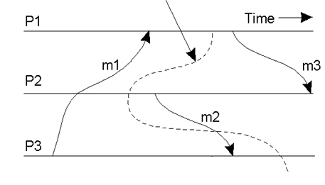
Cuts & Global States
Physical time cannot be perfectly synchronized in a distributed system hence it is impossible to gather the global state of the system at a particular time.
Cuts provide the ability to "assemble a meaningful global state from local states recorded at different times".
A consistent global state is one that corresponds to a consistent cut.
Figure 1-25: The Producer Consumer Problem
A consistent cut (meaningful global state) ?

Slide 77
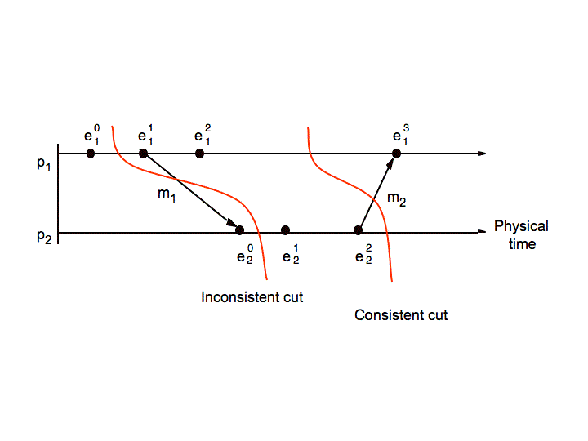
Cuts & Global States…
Figure 1-26: Consistent & Inconsistent Cuts
A consistent cut (meaningful global state) ?

Slide 78
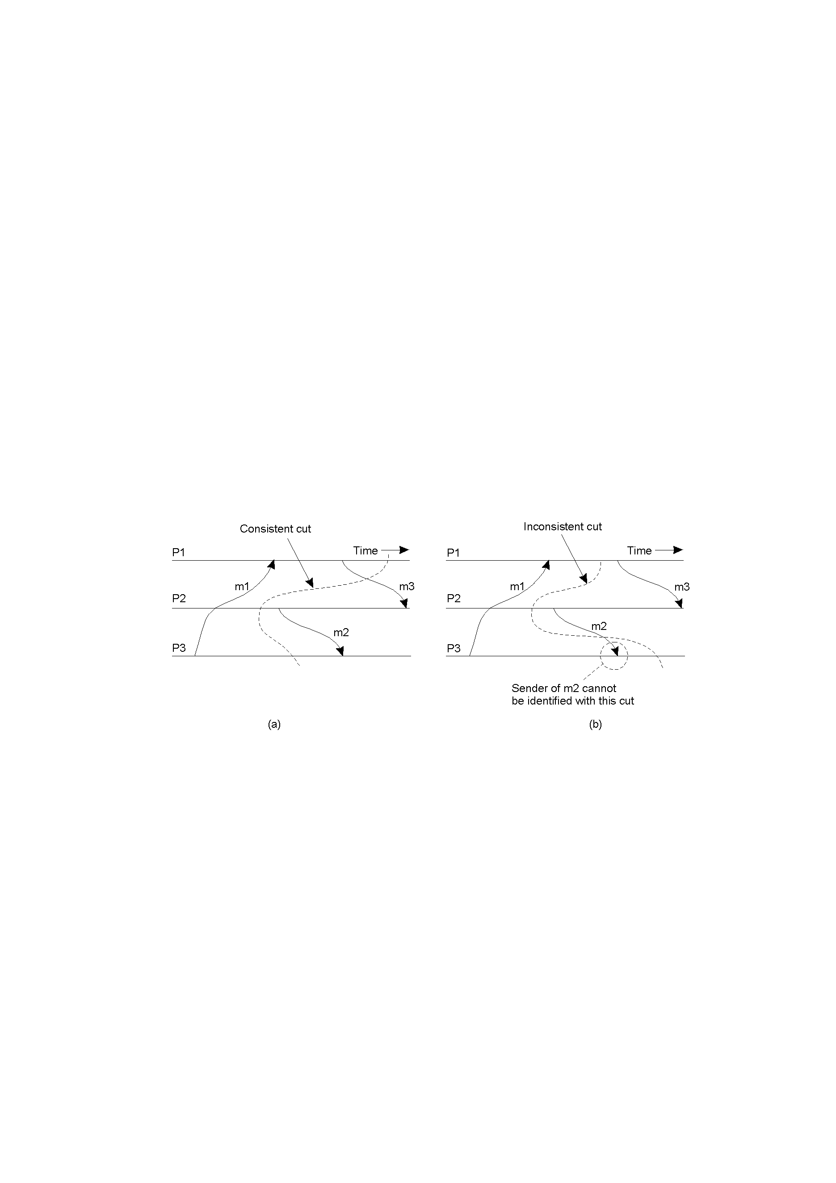
Cuts & Global States…
Figure 1-27: The Producer Consumer Problem
A consistent cut (meaningful global state) ?

Slide 79
Cuts & Global States…
Figure 1-28: The Producer Consumer Problem
A consistent cut (meaningful global state)
An inconsistent cut

Slide 80
The “Snapshot” Algorithm
Records a set of process and channel states such that the combination is a consistent GS.
Assumptions:
  All messages arrive intact, exactly once
  Communication channels are unidirectional and FIFO-ordered
  There is a comm. path between any two processes
  Any process may initiate the snapshot (sends Marker)
  Snapshot does not interfere with normal execution
  Each process records its state and the state of its incoming channels.

Slide 81
Distributed Snapshot Algorithm
When a process finishes local snapshot, it collects its local state (S and C) and sends it to the initiator of the distributed snapshot.
The initiator can then analyze the state.
One algorithm for distributed global snapshots, but it is not particularly efficient for large systems.

Slide 82
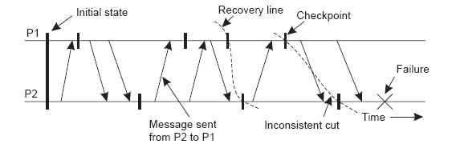
Checkpointing
We’ve discussed distributed snapshots.
The most recent distributed snapshot in a system is also called the recovery line.
Figure 1-29: Cuts & Recovery Lines

Slide 83
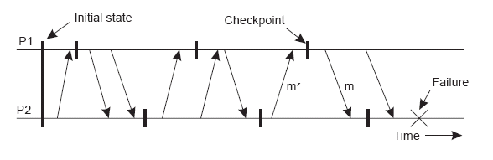
Independent Checkpointing
It is often difficult to find a recovery line in a system where every process just records its local state every so often - a domino effect or cascading rollback can result:
Figure 1-30: Cuts & Recovery Lines

Slide 84
Coordinated Checkpointing
To solve this problem, systems can implement coordinated checkpointing.
We have discussed one algorithm for distributed global snapshots that is not particularly efficient for large systems.
Another way to do it is to use a two-phase blocking protocol (with some coordinator) to get every process to checkpoint its local state “simultaneously”.

Slide 85
Coordinated Checkpointing…
Ensure processes are synchronized when doing the checkpoint.
Two-phase blocking protocol
  Coordinator multicasts CHECKPOINT_REQUEST
  Processes take local checkpoint
  Delay further sends
  Acknowledge to coordinator
  Send state
  Coordinator multicasts CHECKPOINT_DONE

Slide 86
Message Logging
Checkpointing is expensive - message logging allows the occurrences between checkpoints to be replayed, so that checkpoints do not need to happen as frequently.
We need to choose when to log messages.
Message-logging schemes can be characterized as pessimistic or optimistic by how they deal with orphan processes.
  An orphan process is one that survives the crash of another process but has an inconsistent state after the other process recovers.

Slide 87
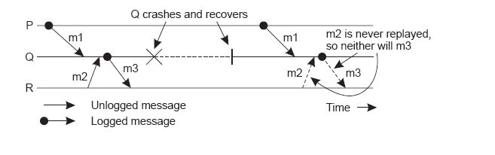
Message Logging…
An example of an incorrect replay of messages.
Example…:
Figure 1-31: Message Logging

Slide 88
Message Logging…
We assume that each message m has a header containing all the information necessary to retransmit m (sender, receiver, sequence no. etc.)
A message is called stable if it can no longer be lost - a stable message can be used for recovery by replaying its transmission.
Figure 1-32: Message Logging

Slide 89
Message Logging
Each message m leads to a set of dependent processes DEP(m), to which either m or a message causally dependent on m has been delivered.
Figure 1-33: Message Logging
The set COPY(m) consists of the processes that have a copy of m, but not in their local stable storage - any process in COPY(m) could deliver a copy of m on request.

Slide 90
Message Logging
Process Q is an orphan process if there is a nonstable message m, such that Q is contained in DEP(m), and every process in COPY(m) has crashed.
Figure 1-34: Message Logging
To avoid orphan processes, we need to ensure that if all processes in COPY(m) crash, no processes remain in DEP(m).

Slide 91
Pessimistic Logging
For each nonstable message m, ensure that at most one process P is dependent on m.
The worst that can happen is that P crashes without m ever having been logged.
No other process can have become dependent on m, because m was nonstable, so this leaves no orphans.
Figure 1-35: Message Logging

Slide 92
Optimistic Logging
The ‘work’ is done after a crash occurs, not before.
If, for some m, each process in COPY(m) has crashed, then any orphan process in DEP(m) gets rolled back to a state in which it no longer belongs in DEP(m).
Figure 1-36: Message Logging

Slide 93
Pessimistic vs Optimistic Logging…
Dependencies need to be explicitly tracked, which makes Optimistic Logging difficult to implement;
As a result, Pessimistic approaches are preferred in real-world implementations.

Slide 94
Summary
Introduction
Process Resilience
Reliable Communication
Distributed Commit
Recovery

Slide 95
Recommended Reading
  http://research.microsoft.com/en-us/um/people/lamport/pubs/using-time.pdf
  http://www.dre.vanderbilt.edu/~gokhale/WWW/papers/Milcom07_ARMS.pdf
  http://crystal.uta.edu/~kumar/cse6306/papers/FaultTolerantDistComp.pdf

Slide 96
Next Week……
Quiz I & Assignment I
Communication Systems

